Slide 1
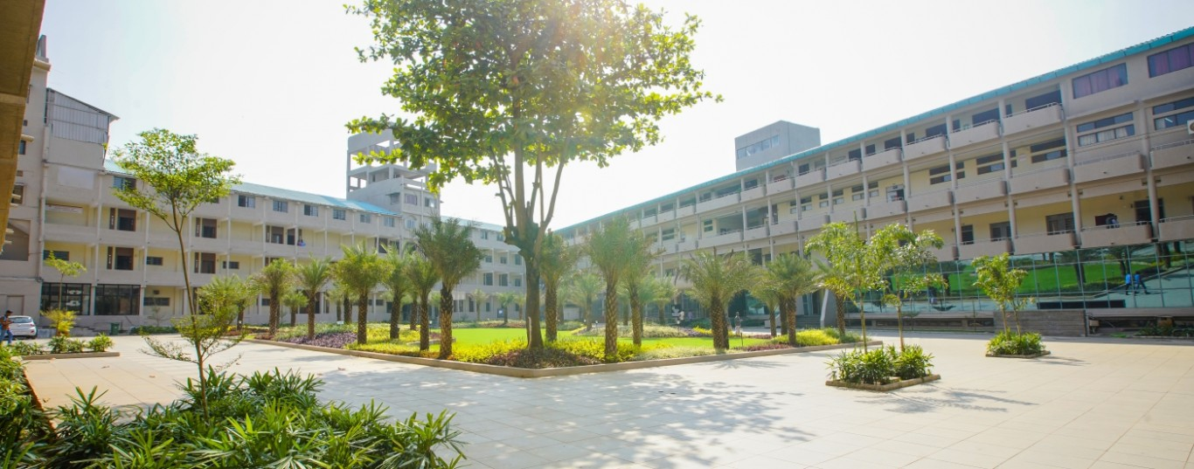

D.Y. PATIL COLLEGE OF ENGINEERING AND TECNOLOGY, KASBA BAWDA, KOLHAPUR
A project presentation on
“Sign Language Recognition”
Under The Guidance Of
Mrs. Tejashree Deokar

Slide 2
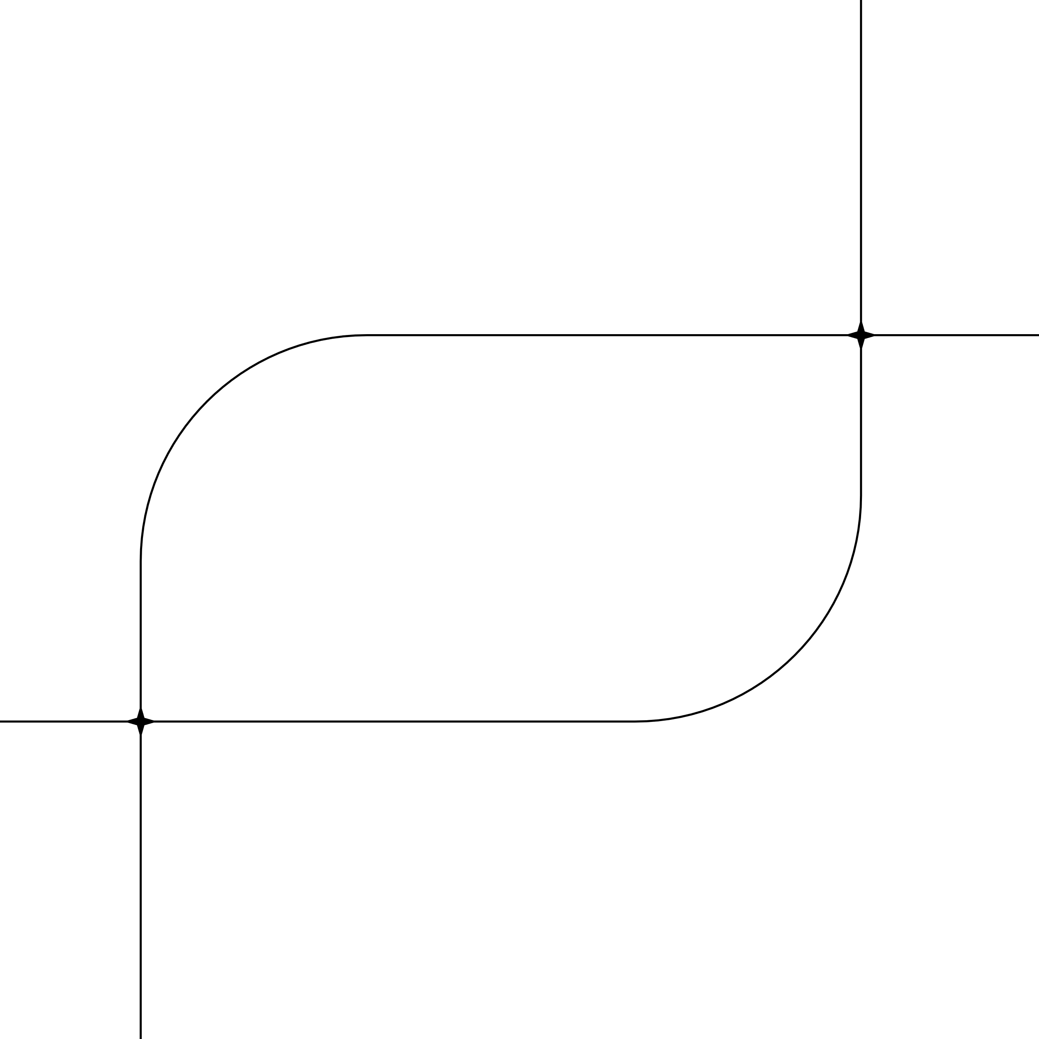
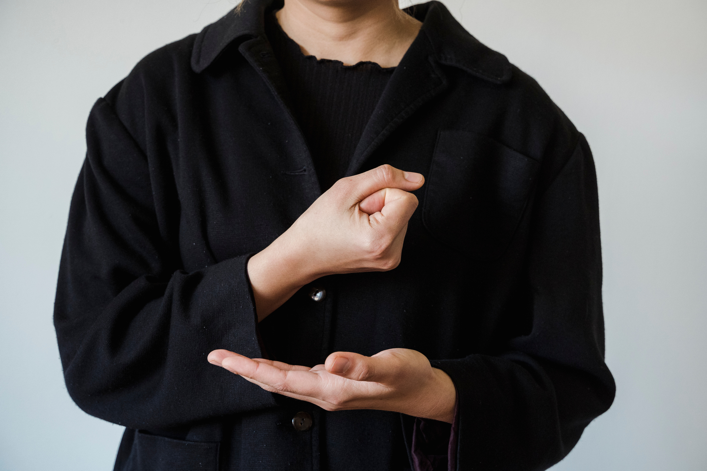
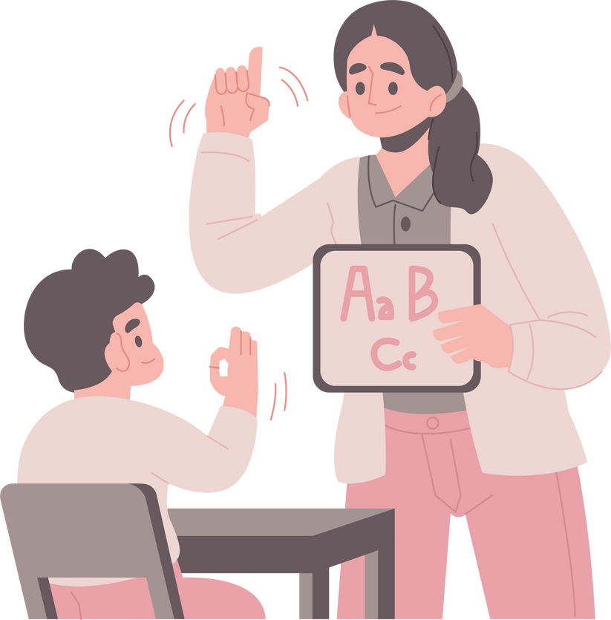
Sign Language Recognition
Anuj Ravindra Pawar
Satyam Vinod Panchal
Shailesh Santosh Jadhav

Slide 3
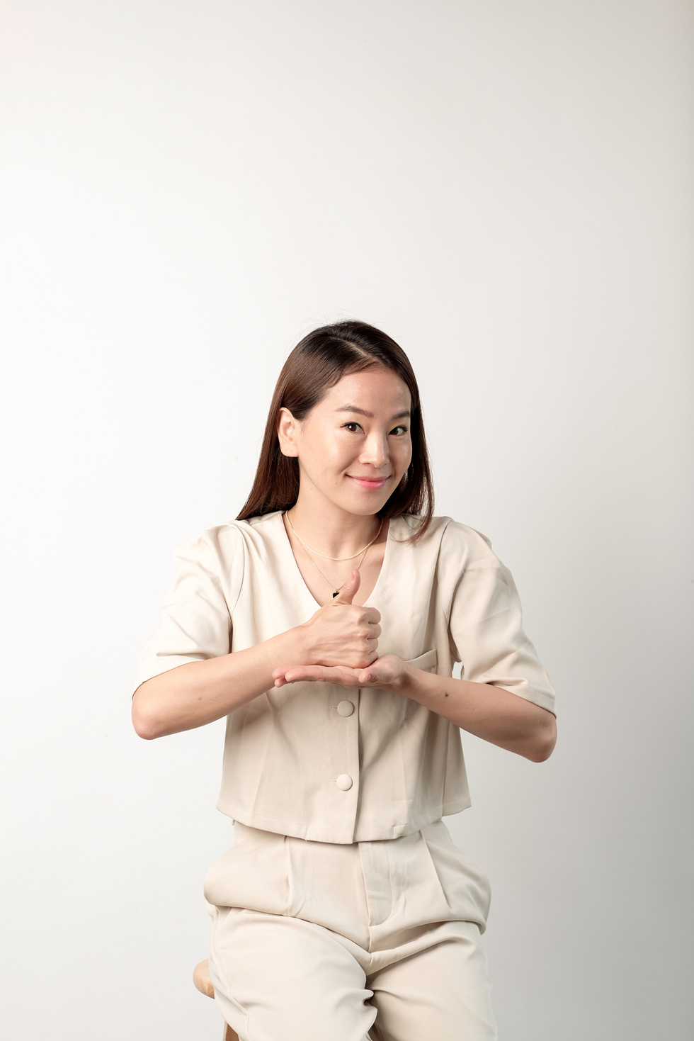
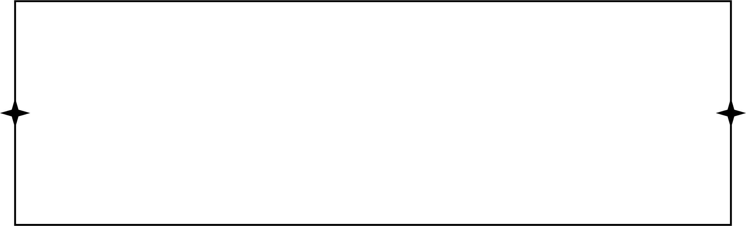
Introduction
Children with disabilities often encounter barriers to accessing effective cognitive retraining programs, hindering their ability to develop crucial cognitive skills.
In response to these challenges, there is a growing recognition of the importance of developing innovative diverse communication preferences.
This project is a first step towards building a possible sign language translator, which can take communications in sign language and translate them into written language.

Slide 4
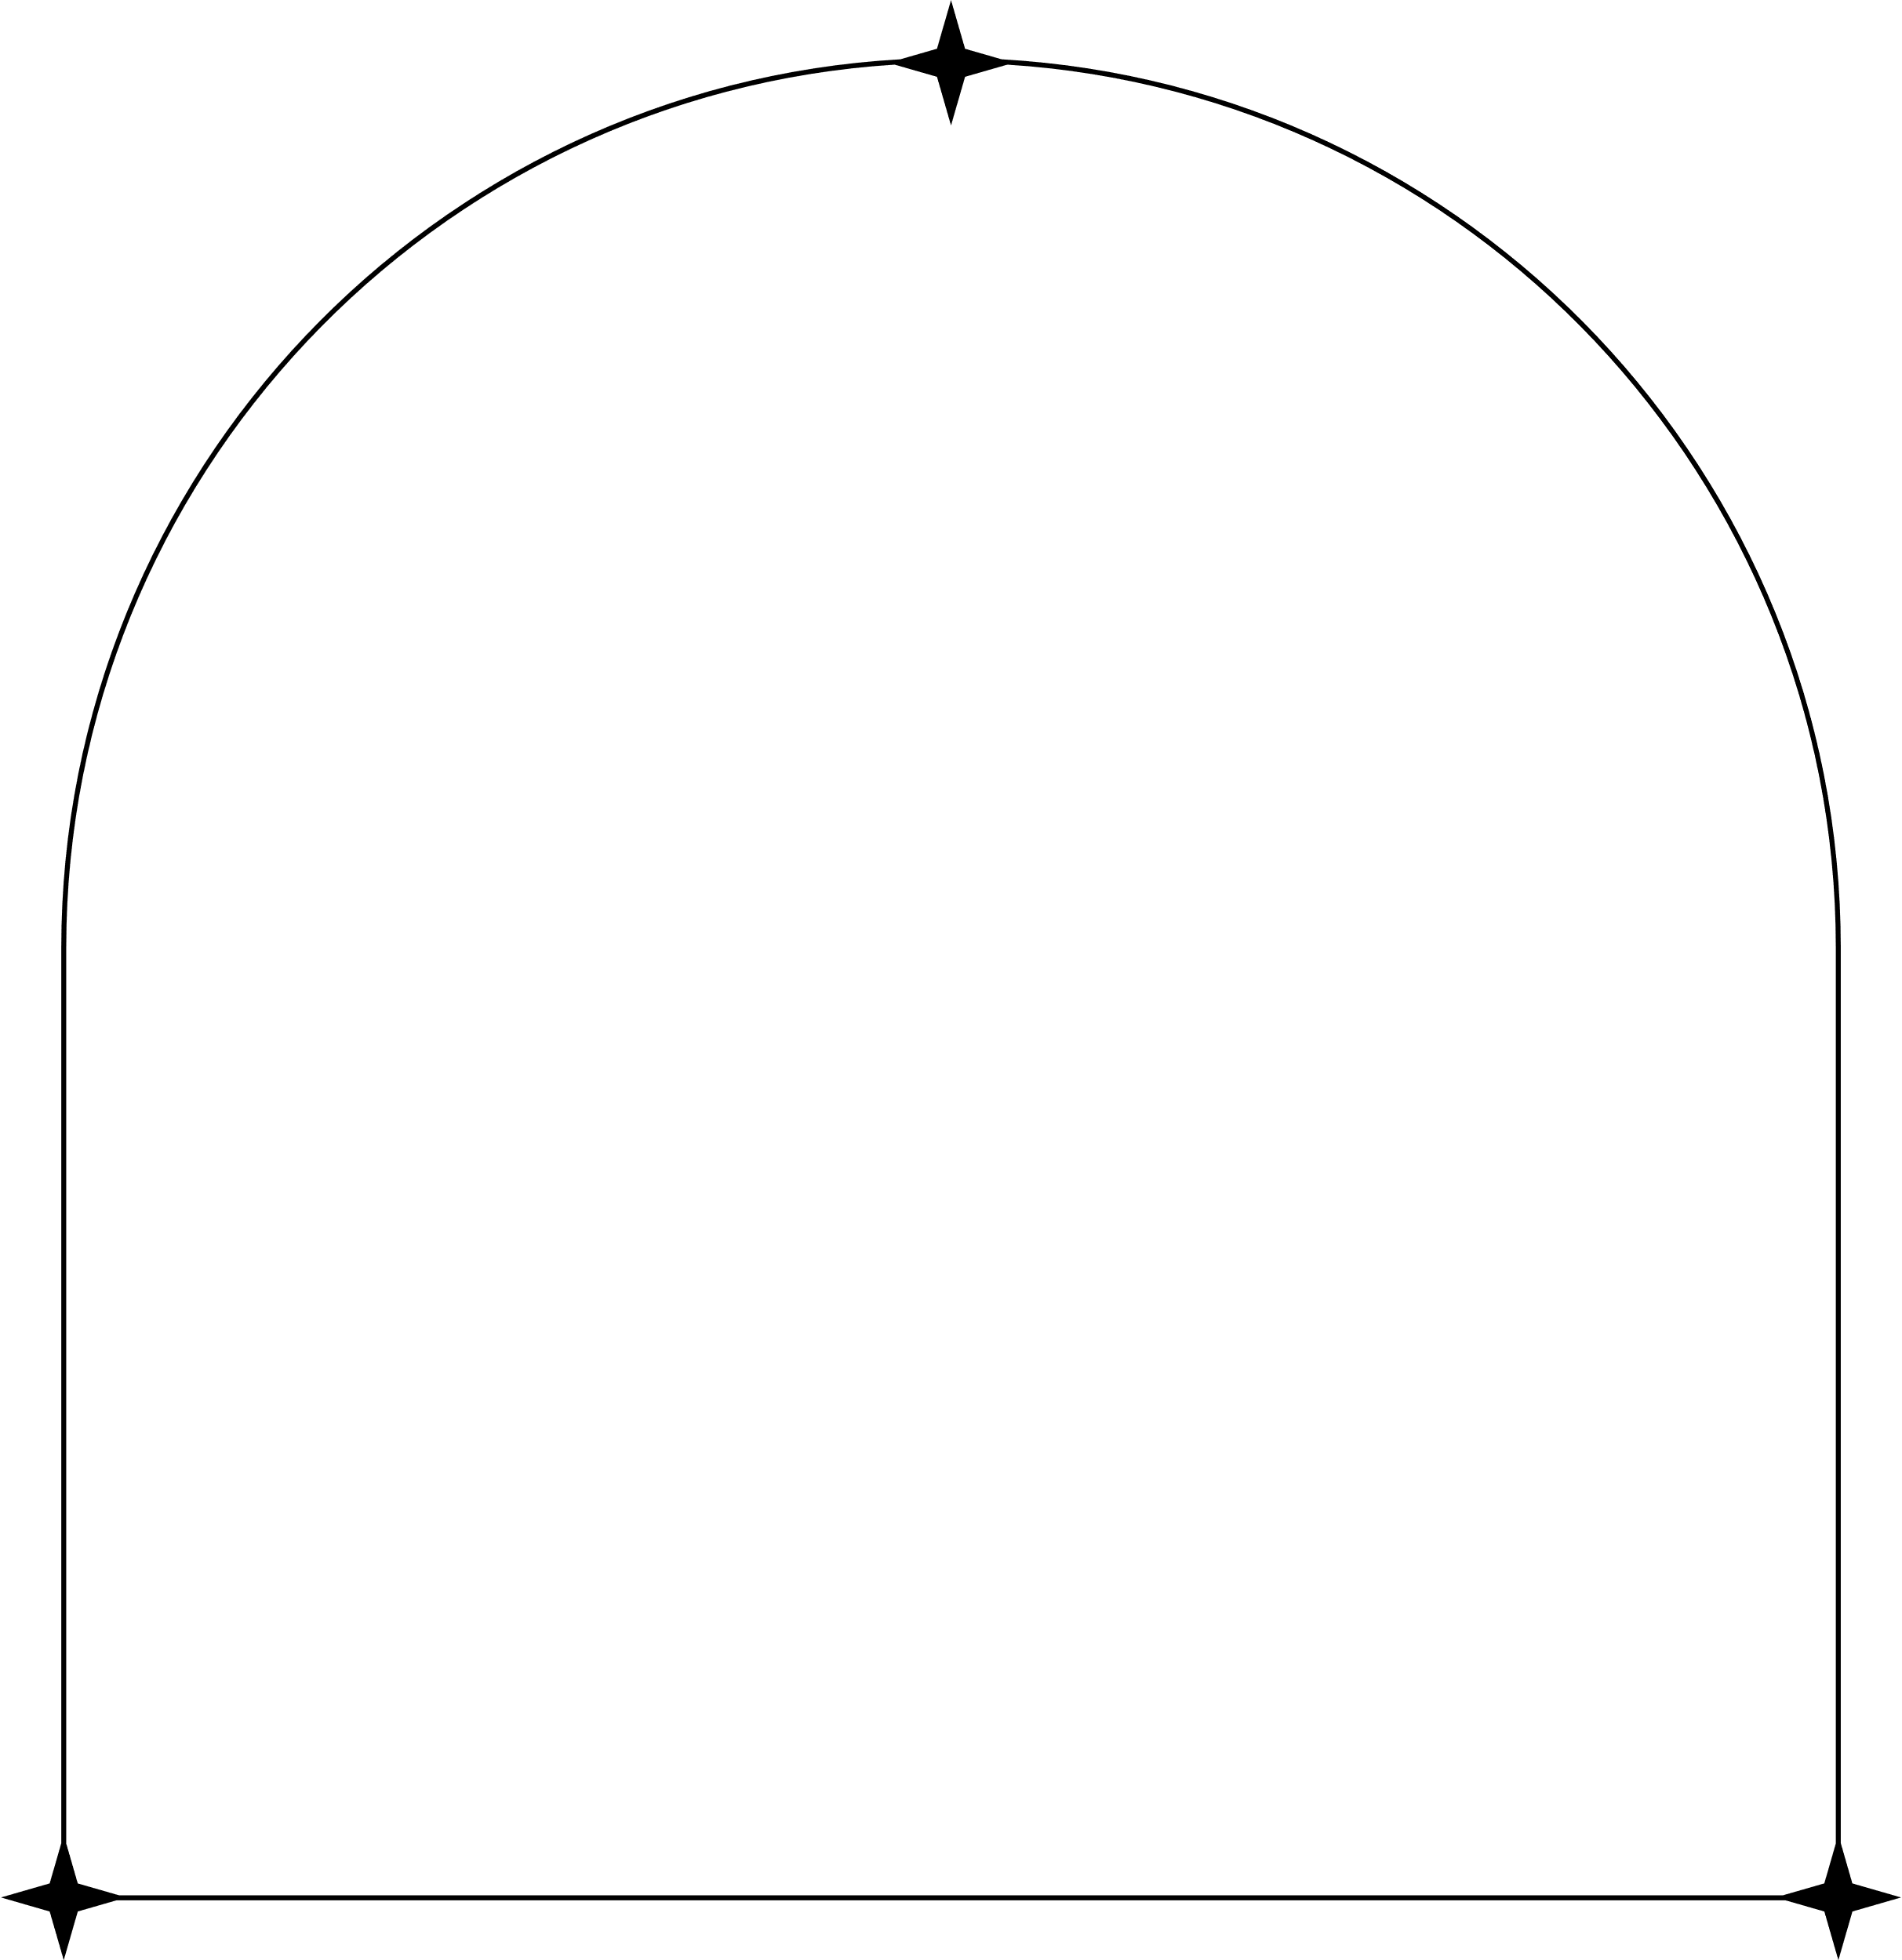
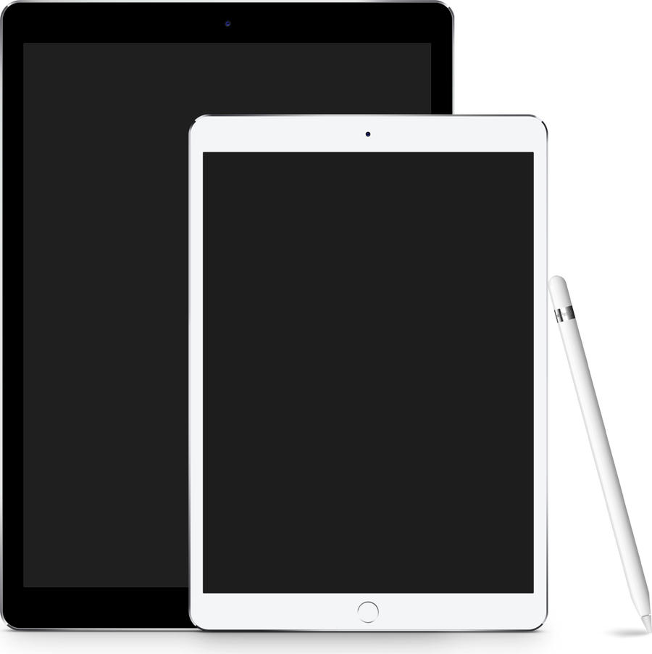

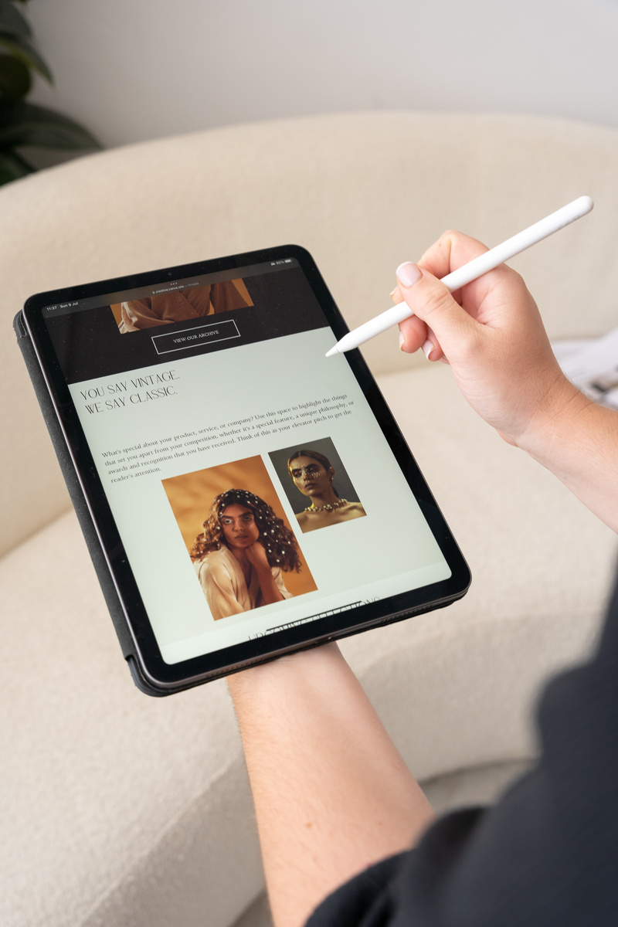
Problem Statement & Objectives
Problem Statement
The problem at hand necessitates the exploration of strategies to enhance the accessibility and inclusivity of cognitive retraining programs for children with disabilities, particularly those who rely on sign language as their primary mode of communication

Slide 5
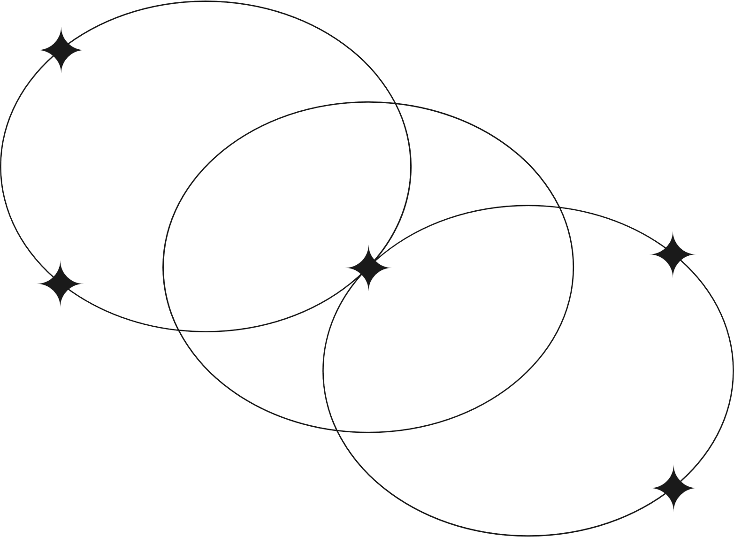
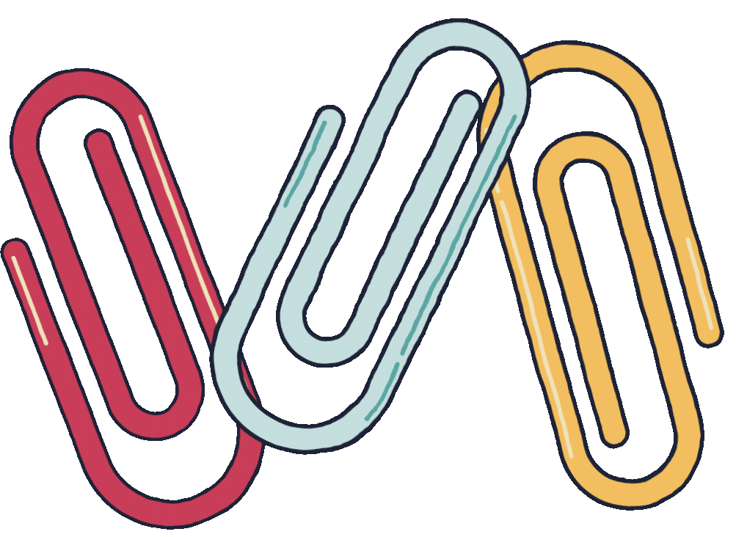
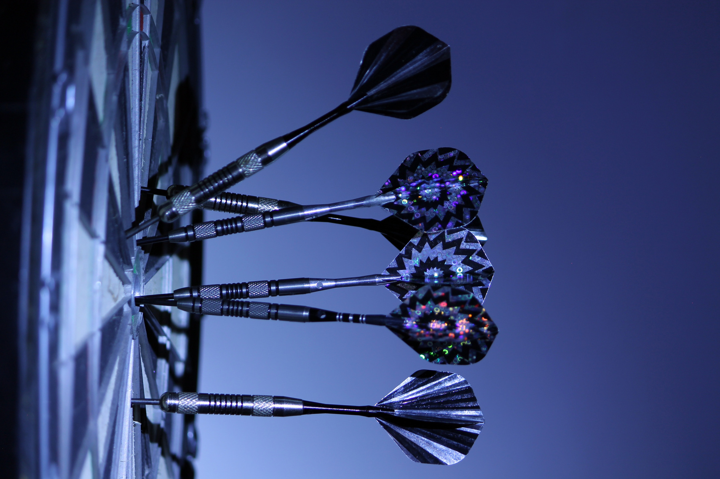


objectives
To Identify specific communication challenges faced by children with disabilities.
To Create a Computerized Cognitive Retraining Program (CCRP) tailored to the cognitive abilities and needs of children with disabilities.
To Evaluate the impact of the integrated CCRP and Sign Language Detection Web App on cognitive skills, communication abilities.

Slide 6
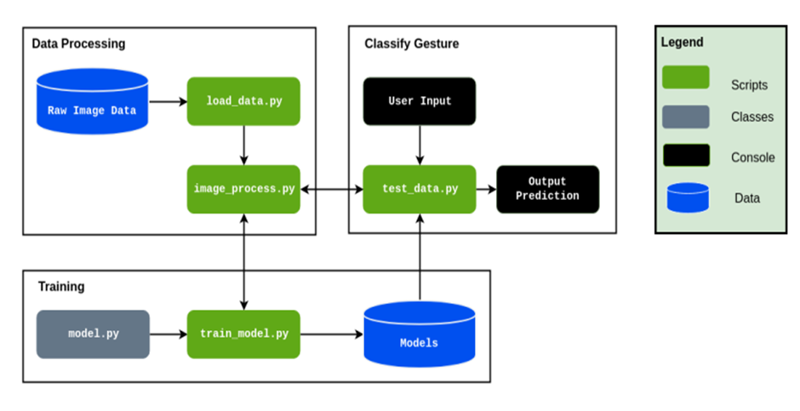
System Design

Slide 7

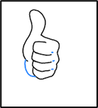


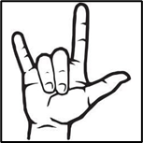

Raw Image Data:-
The primary source of data for this project was the compiled dataset of American Sign Language (ASL)
There are 8 total classes, each with 500 images, 8 words are “Good”, “Hello”, “I love you”, “Yes”, “No”, “Please”, “Okay”, “Thank You”.
OKAY
HELLO
YES
I LOVE YOU

Slide 8
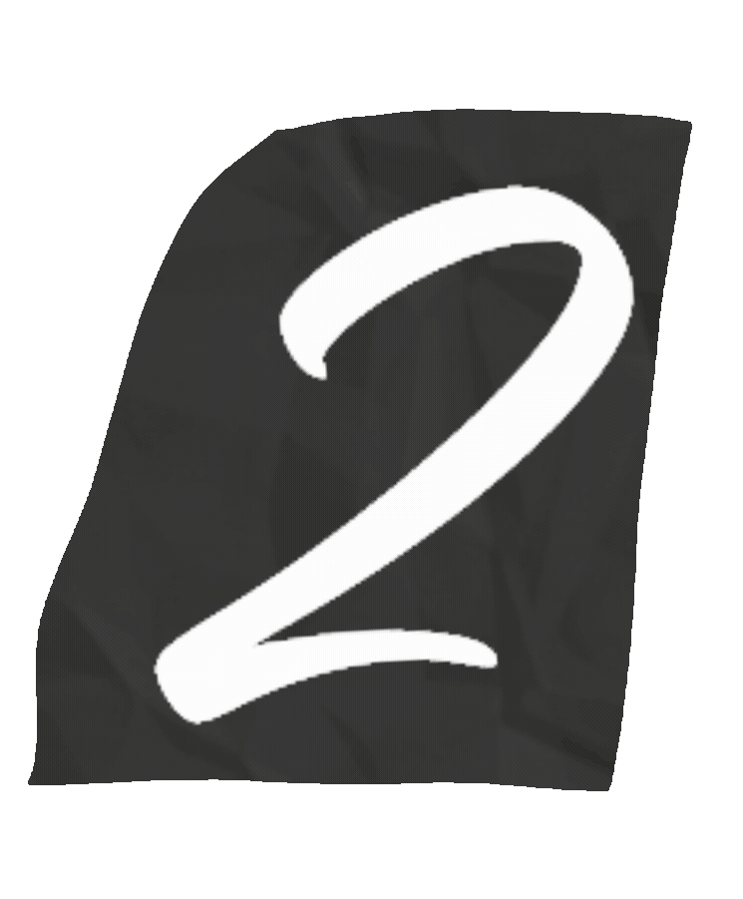
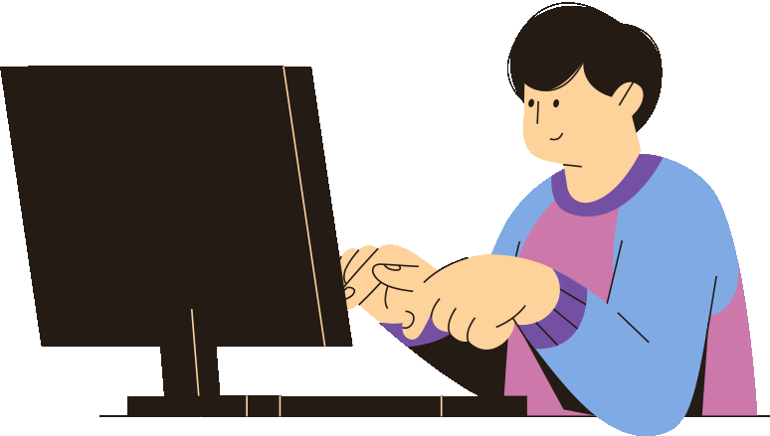
Data Pre-processing:
All the images are uploaded to the Google Teachable Machine For training.
Total 8 Classes were created and images were uploaded as per classes. Each class has given their name.
Google Teachable Machine train the model and it is converted into Keras (.h5) format which can be compiled by Tensor flow.

Slide 9
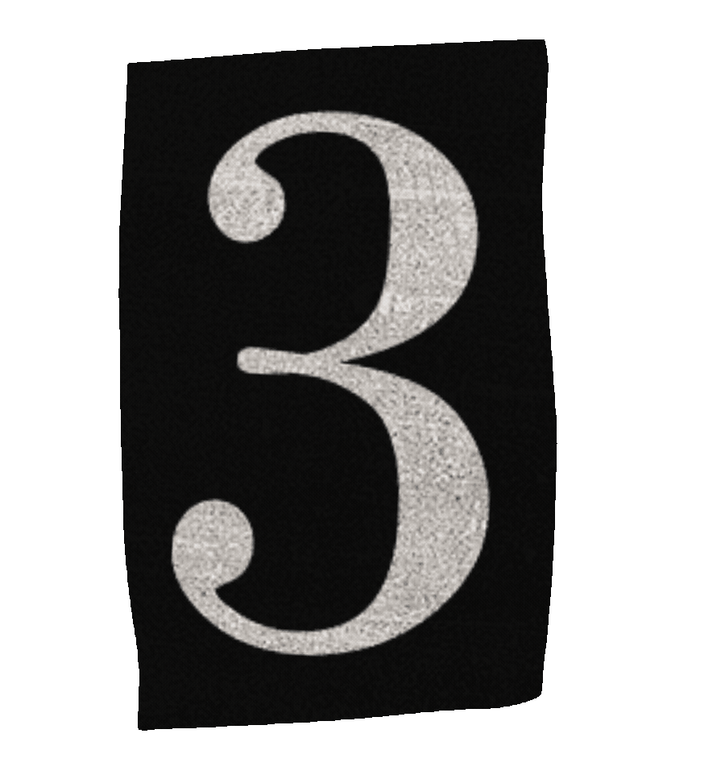

Image Enhancement:
A combination of brightness, contrast, sharpness, and color enhancement was used on the images.
Image pre-processing contains removing unwanted noise, adjusting brightness and contrast of the image, cropping the image as per requirement.

Slide 10
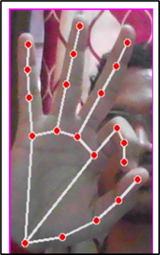
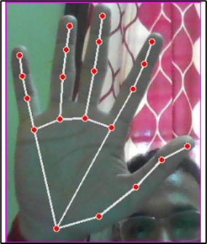
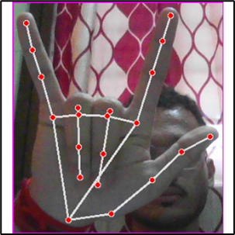
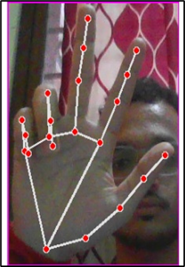
Image Enhancement

Slide 11
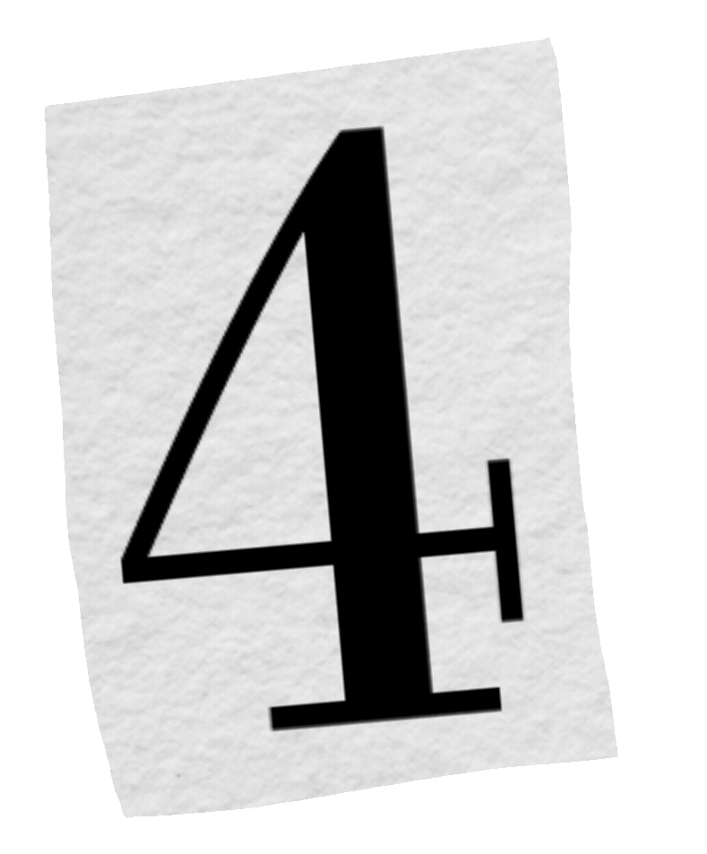
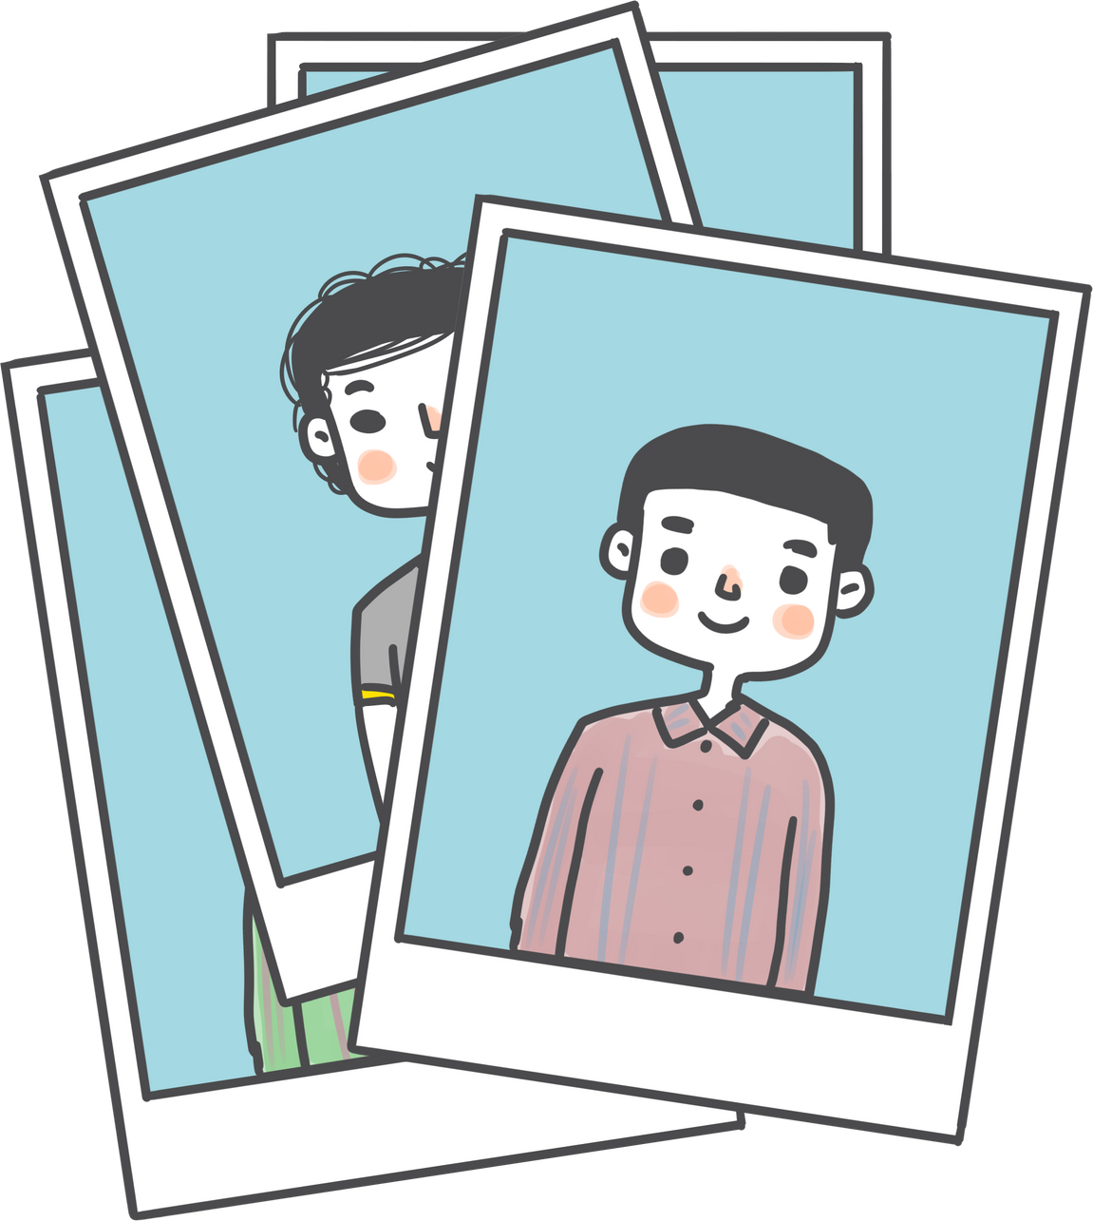
Image Whitening:
ZCA algorithm decorrelates the data, and removes the redundant, or obvious, information out of the data.
This allows for the neural network to look for more complex and sophisticated relationships
and to uncover the underlying structure of the patterns it is being trained on.

Slide 12


SOFTWARE AND HARDWARE REQUIREMENTS
HARDWARE REQUIREMENT:-
Processor: Multi-core processor with adequate processing power.
Memory (RAM): Sufficient RAM for data processing and analysis.
Storage: High-capacity storage for storing historical data and analysis results.
Graphics Processing Unit: Dedicated graphics unit for smooth operation

Slide 13
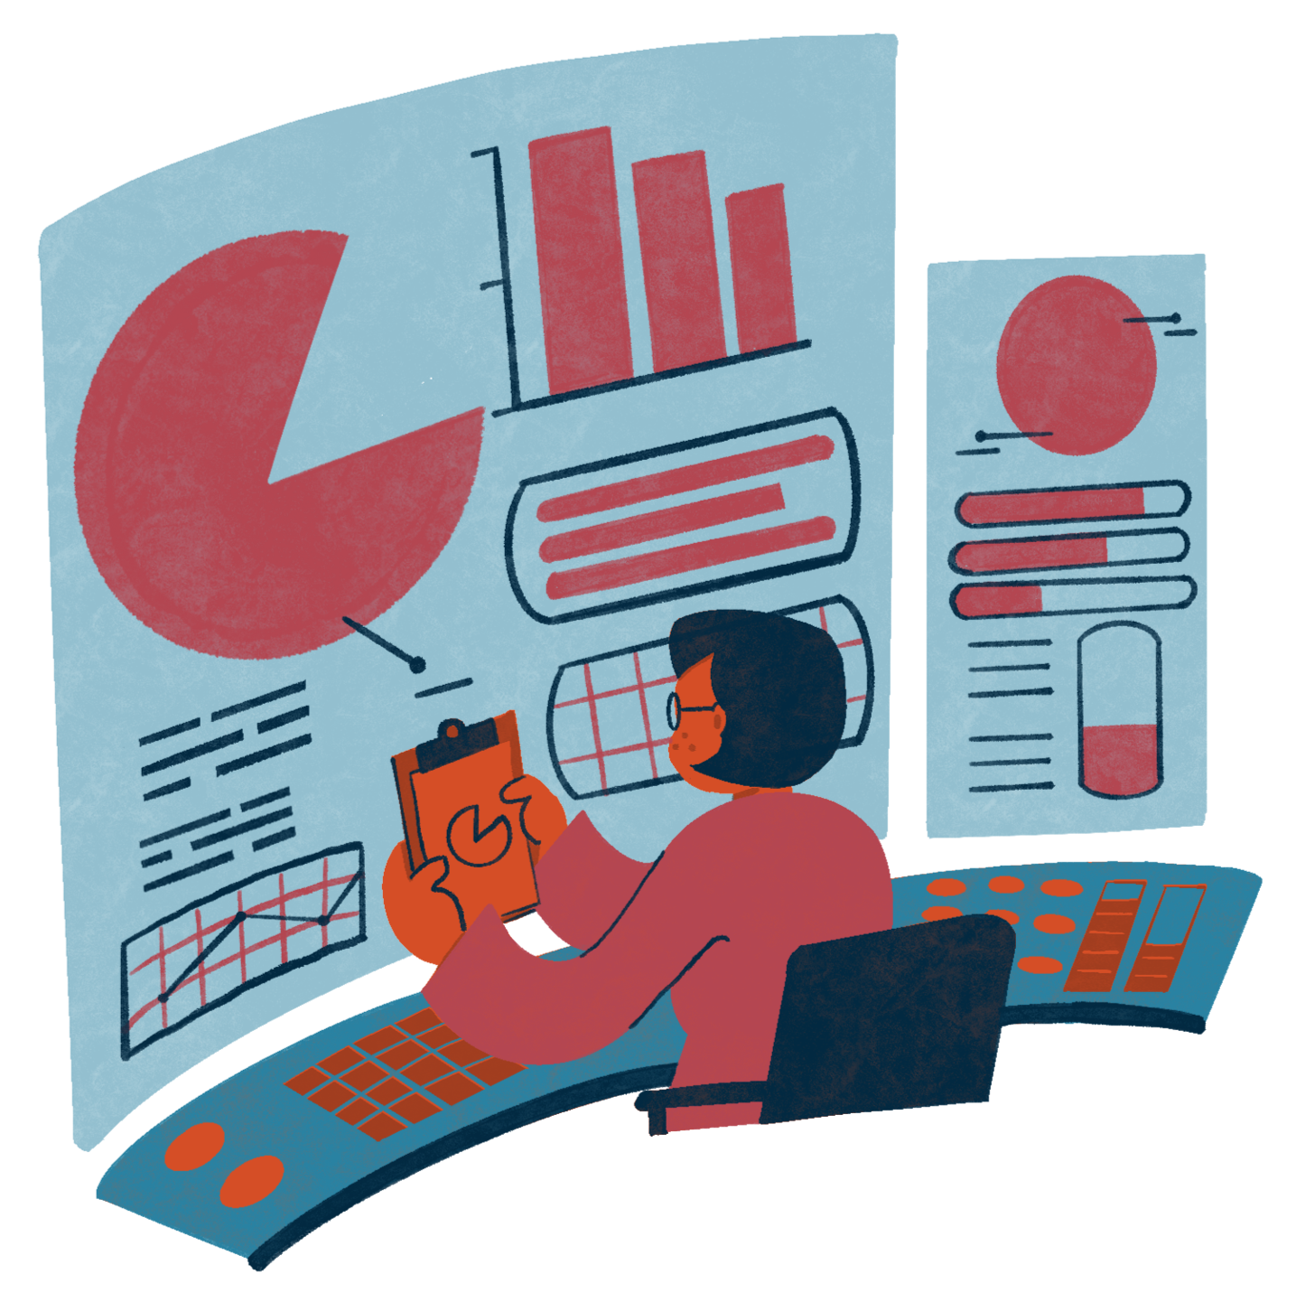
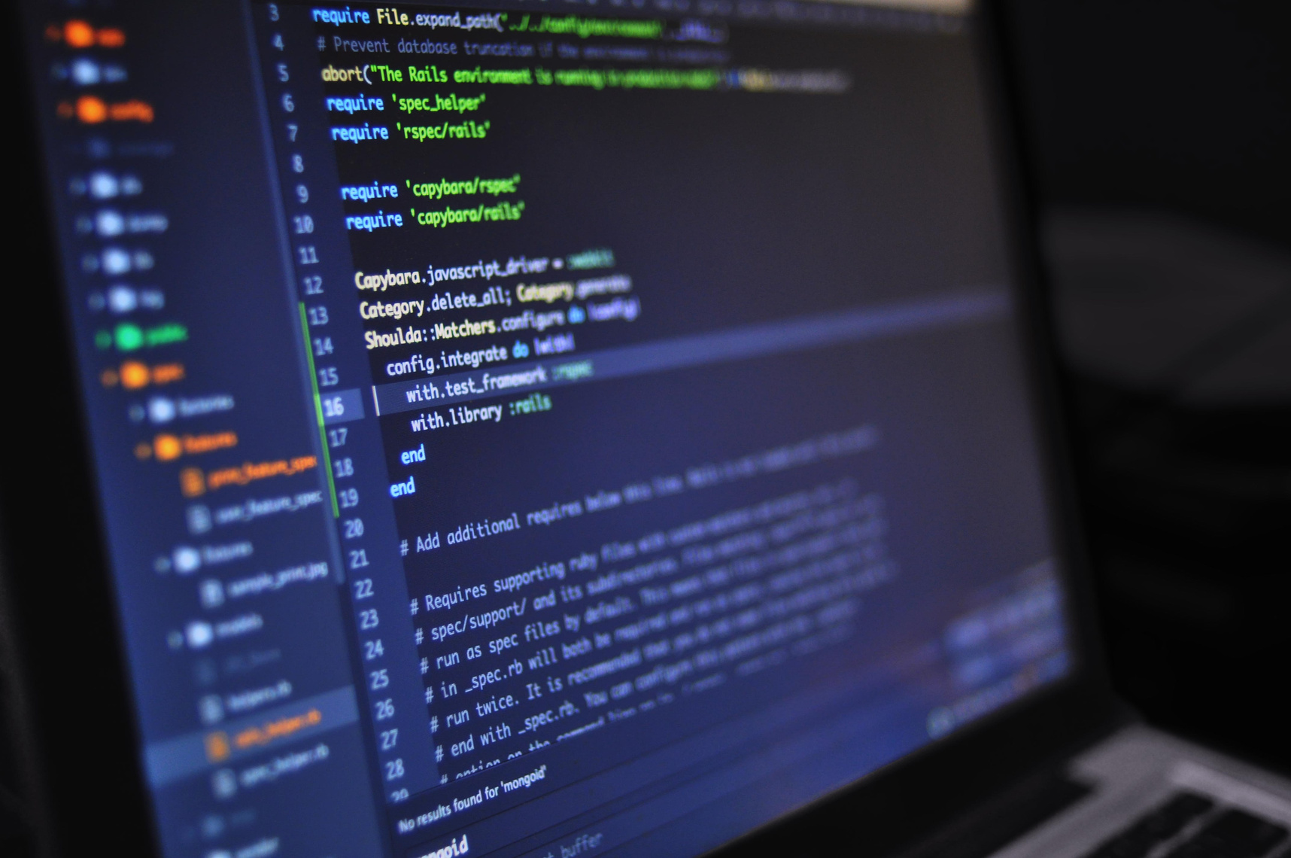
Software Requirement: -
Operating System: An operating system (OS) is software that manages computer hardware and provides services for computer programs.
Python: Entire project is created using the python and its supporting libraries and modules.
TensorFlow: for building and training machine learning models.
OpenCV (Open-Source Computer Vision Library): Used for Object detection and Video processing.
Google Teachable Machine:

Slide 14

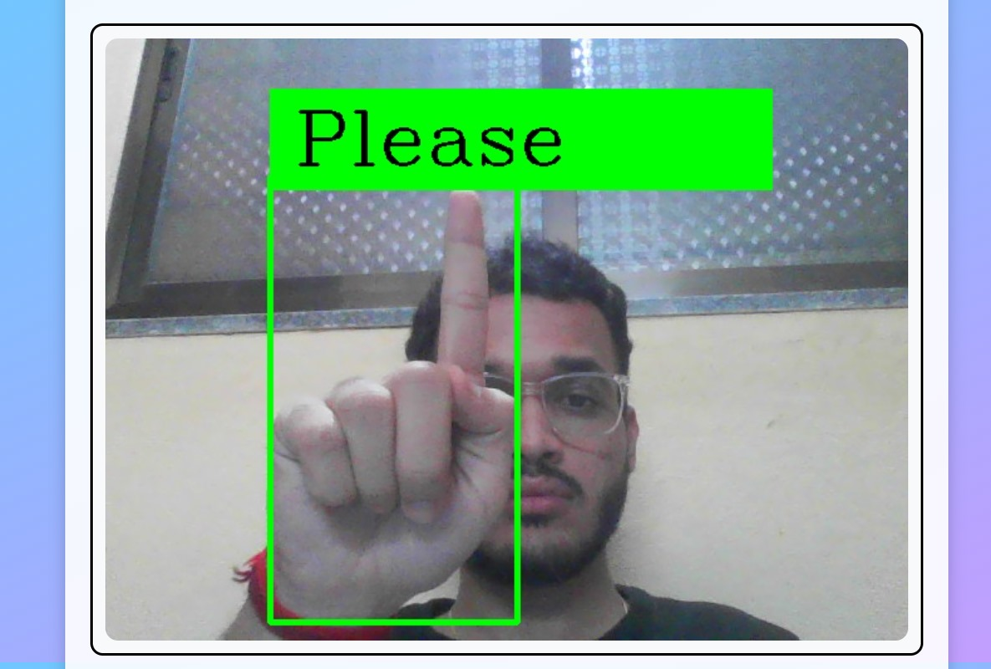
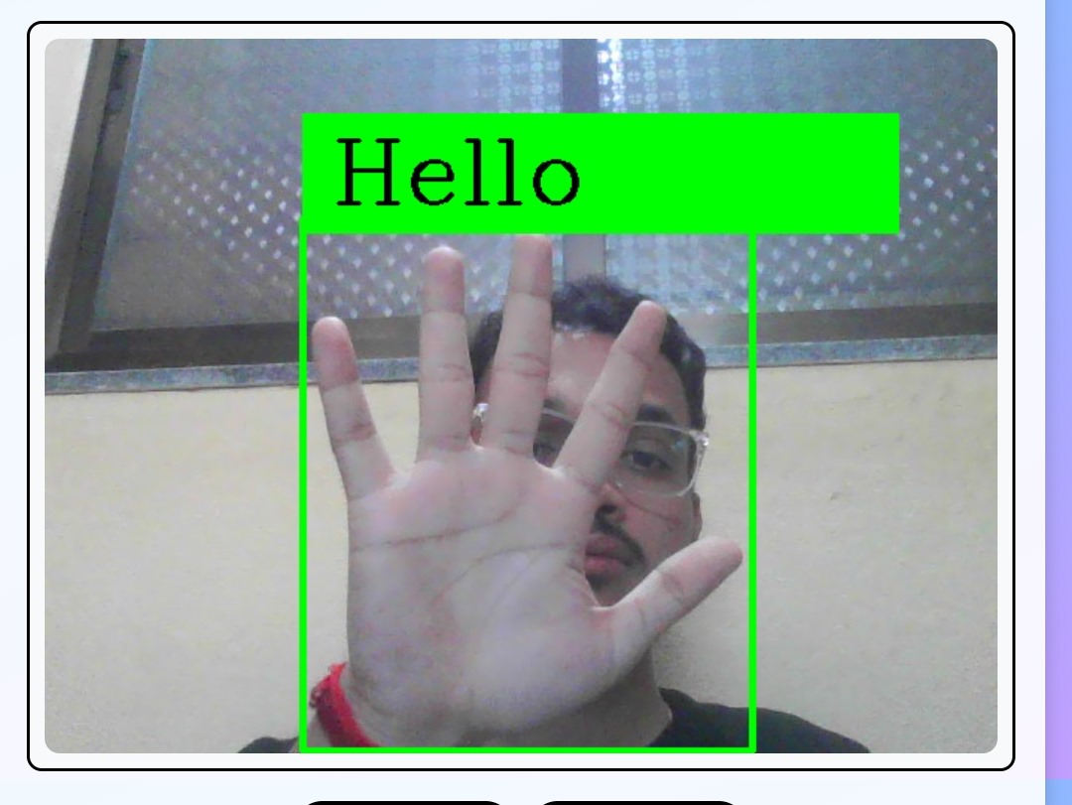
Result Analysis
The system was trained on a dataset consisting of sign language gestures from various sources and recordings.
The system achieved an accuracy of 80%, indicating that it correctly identified 80% of the sign language
While 80% accuracy is a respectable performance, there is room for improvement.

Slide 15
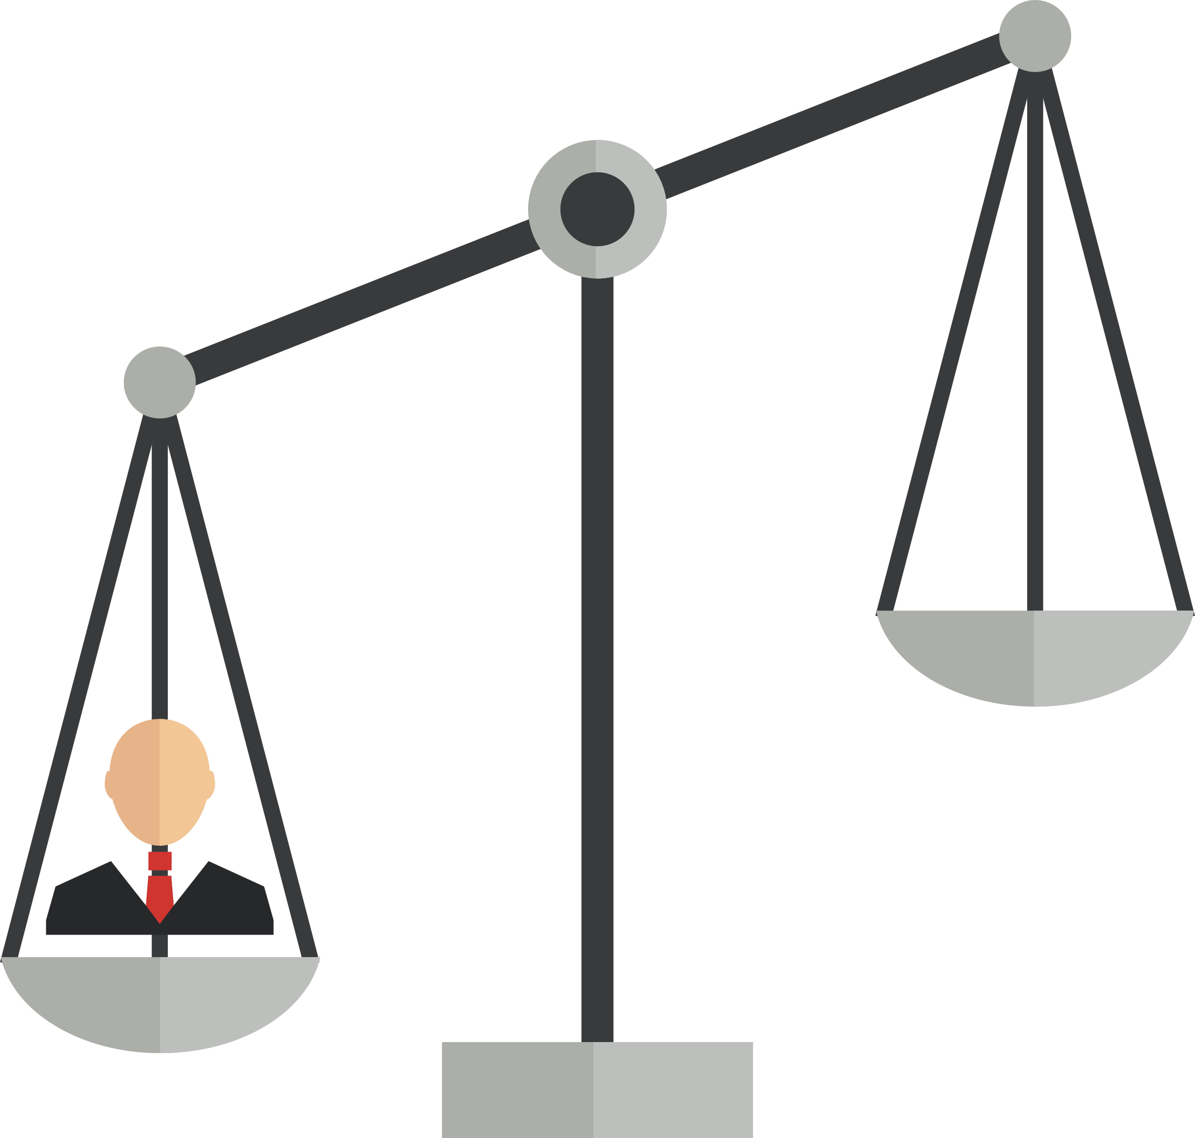

Conclusion
The system that can successfully recognize dynamic movements that comes in continuous sequences of images.
The system shows that the first stage can be useful for deaf persons or with speech disability for communicating.
In this work, the developed hardware architecture is used as image recognizing system, it means, the design can be employed to process other type of signs.

Slide 16
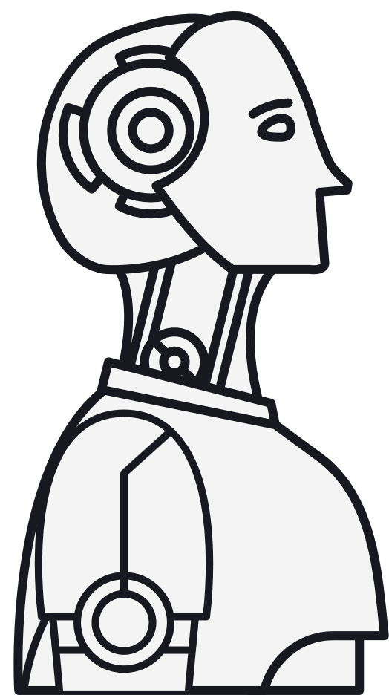
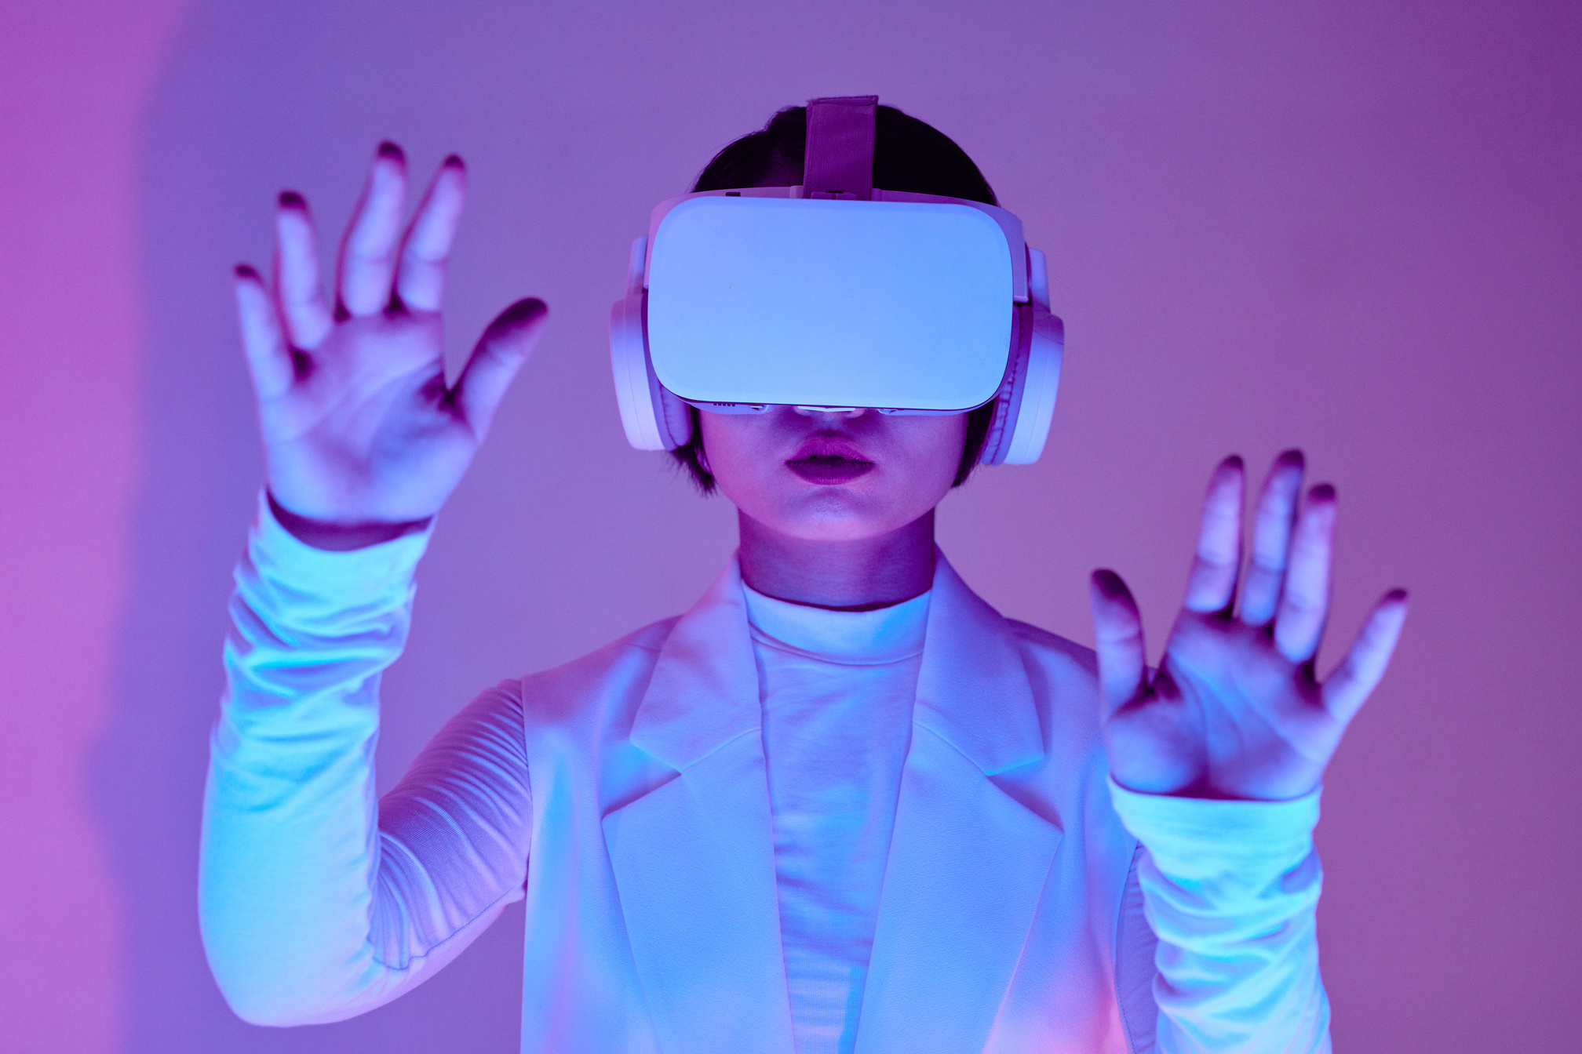
Future Scope
Future research can focus on enhancing the accuracy and performance of sign language detection systems through deep learning.
Expanding sign language detection systems to support multiple sign languages and dialects.

Slide 17
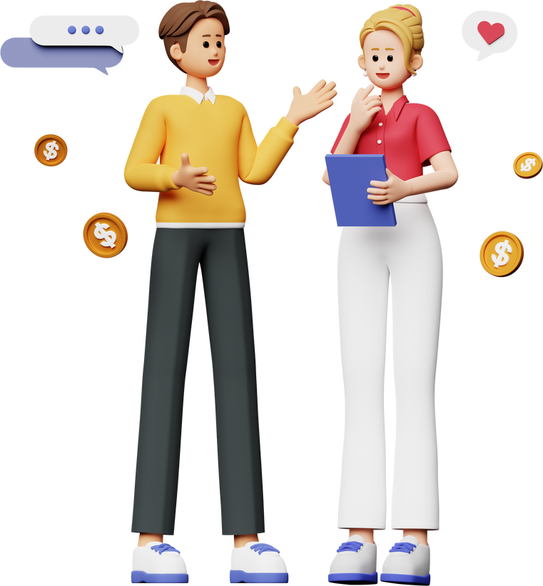
References
Online Resources:
Tensorflow Global Community - https://www.tensorflow.org/community
Chatgpt - https://chat.openai.com/c/1f531c51-52bf-4c4c-8a92-6e63f2ca15a8
Google Teachable Machine - https://teachablemachine.withgoogle.com/
Research Papers:
Anna Deza (1003287855) and Danial Hasan (1003132228) - "Sign Language Recognition”
“SIGN LANGUAGE RECOGNITION USING NEURAL NETWORK” KAUSTUBH JADHAV, ABHISHEK JAISWAL, ABBAS MUNSHI, MAYURESH YERENDEKAR, Department of Electronics and Telecommunication Engineering K.C. College of Engineering & Management studies & Research
“Real Time Sign Language Detection” by Sneha Santoshkumar Riya Divakaran Shruti Krishnakumar Sukrishna Nair of Department Of Computer Engineering PILLAI COLLEGE OF ENGINEERING New Panvel – 410 206 UNIVERSITY OF MUMBAI

Slide 18
Thank you!

